Slide 1
Meeting 12-08
Goal of this meeting:
  Where are we currently standing
  Current formulation of the problem
    Feedback to put in the right direction

Slide 2
Overview
Refresh system and augmentation implementation
Where are we currently standing
Problem definition with ANN training
  Offset between baseline model and system
  ANN cannot beat the linear encoder initialization
Only ANN training
  BLA init vs random init

Slide 3

Baseline model

Slide 4

System for data generation

Slide 5

Augmentation
Overview
Notes:
Kijken gaug is dat augmented states?

Slide 6
Where are we currently standing
Still in simulation without noise
The ANN correction does not beat the linear encoder initialization
  Replaying inputs from system in closed-loop WITH MSD in the baseline model WITHOUT MSD creates an offset
  Seems to be a mismatch between windowed and long term dynamics: ANN training loss decreases but 12 s validation increases
    But increasing nf (sample length) does not resolve this

Slide 7
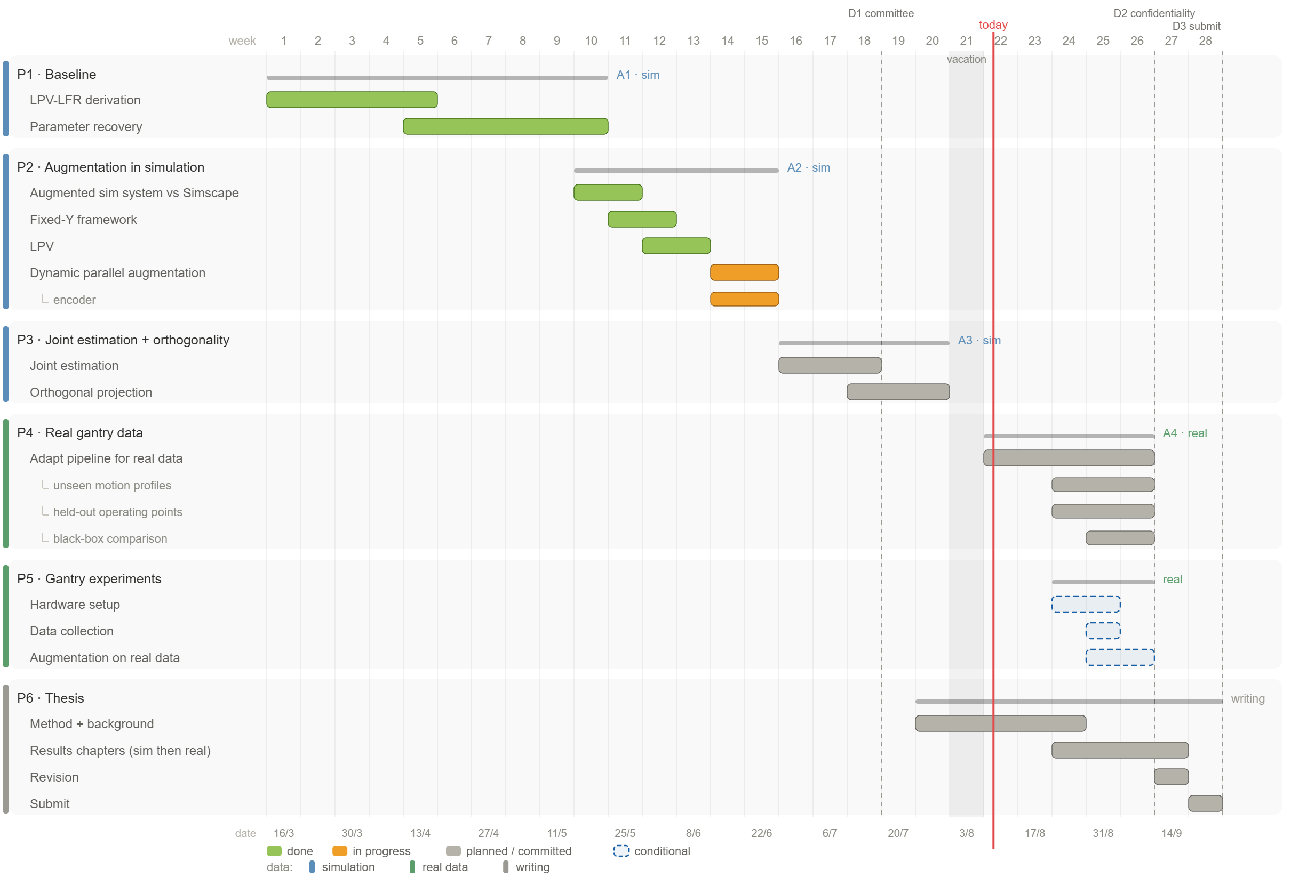

Slide 8
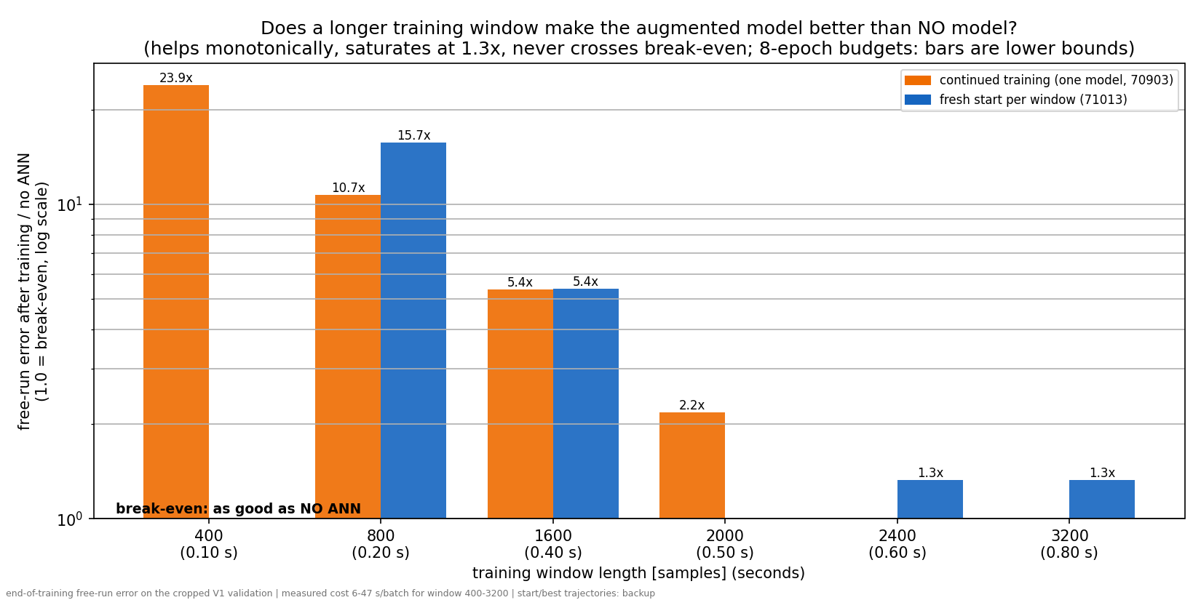

Slide 9
Hyperparameter search:
Learning rate and number of samples used for training (training window)
Conclusion: it is not a hyperparameter problem

Slide 10
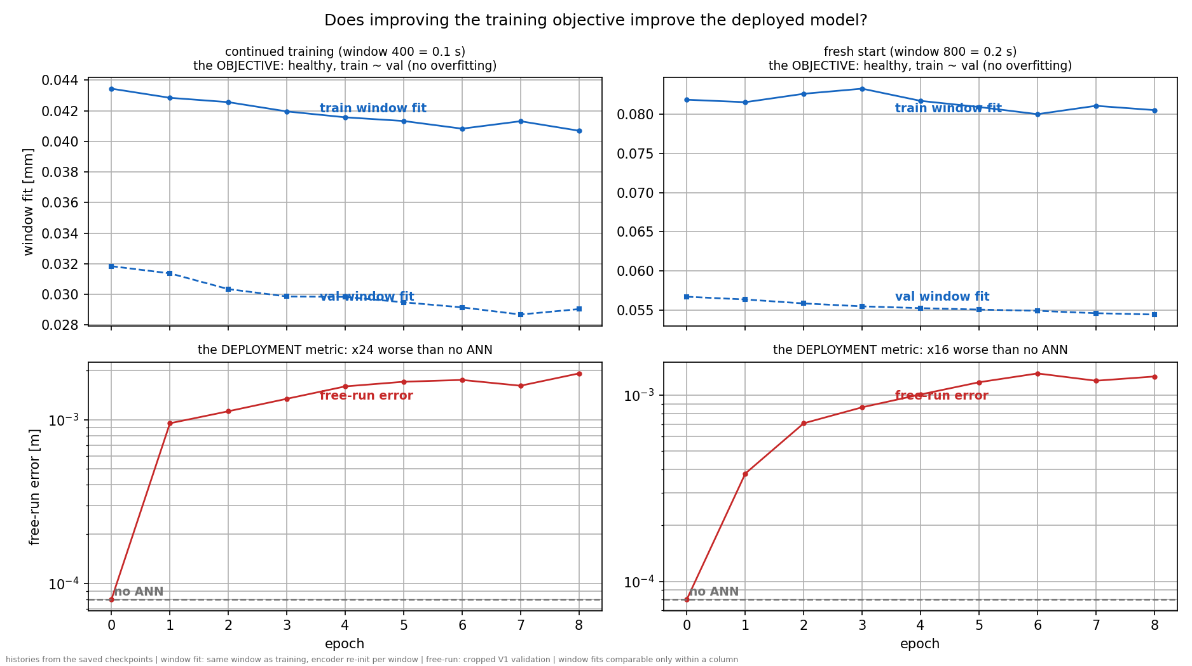
Look at train and validation loss for the training window
Why:
For validation we use sim-RMS, which is the full 12s validation open-loop free run and now 0.1 s

Slide 11
Current problem
Offset what is creating this
Poles at z=1, what issue causes this?
Read docs\gantry-augmentation-problem-log.md
Zero mean.
  Kijken naar per window. Init perfect zero mean anders niet per window.
  Dit voor matching baseline met system?
  Correct correctie truth-baseline is zero mean. Maar we kunnen dit dus ook per window. Want dat is over de gehele trajectory (hoe generate ik dat)
    en dat is niet wat we zien per training window.

Slide 12
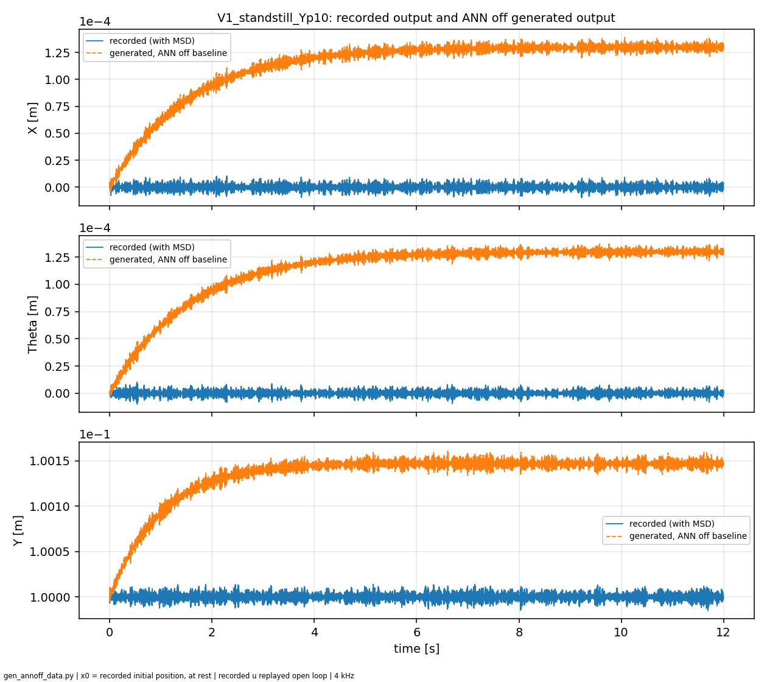
Offset between baseline model and system
Replay recorded input of system with MSD in open-loop for baseline model without MSD

Slide 13
Offset between baseline model and system
Replay recorded input of system with MSD in open-loop for baseline model without MSD
What is creating this offset?

Slide 14
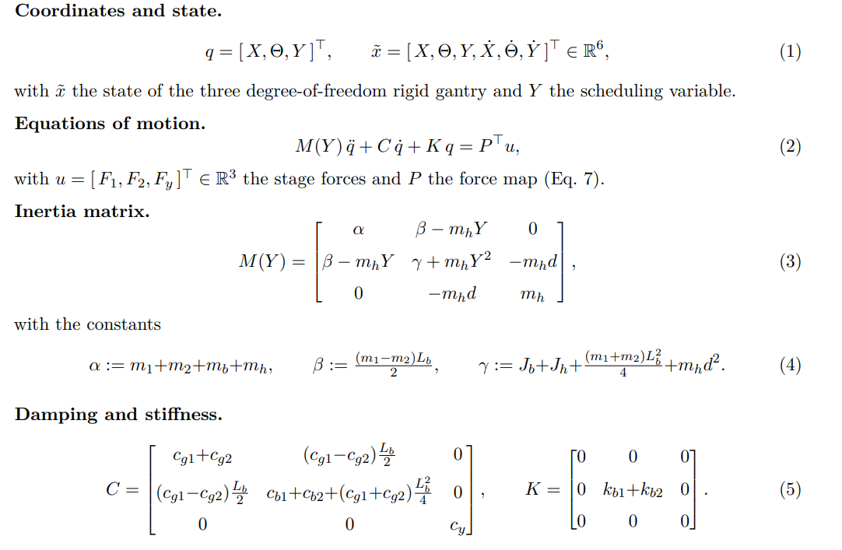
Baseline model

Slide 15
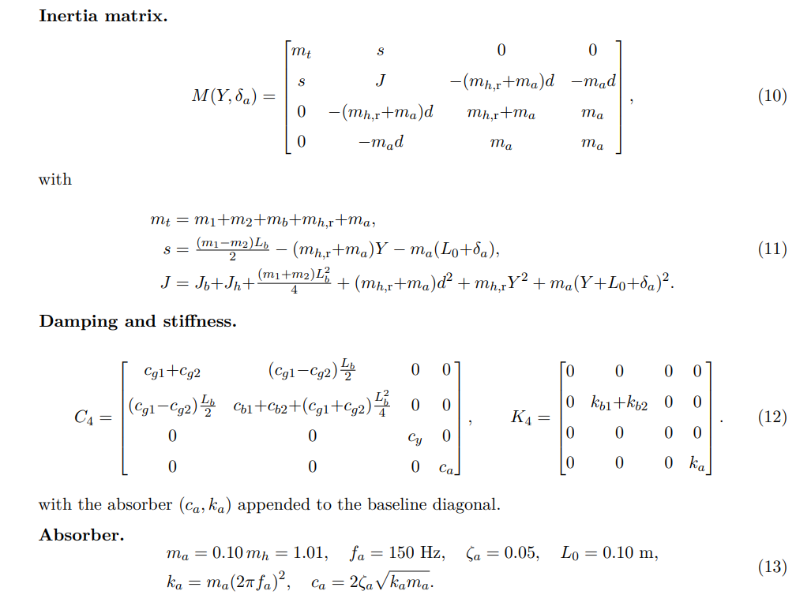
System with MSD

Slide 16
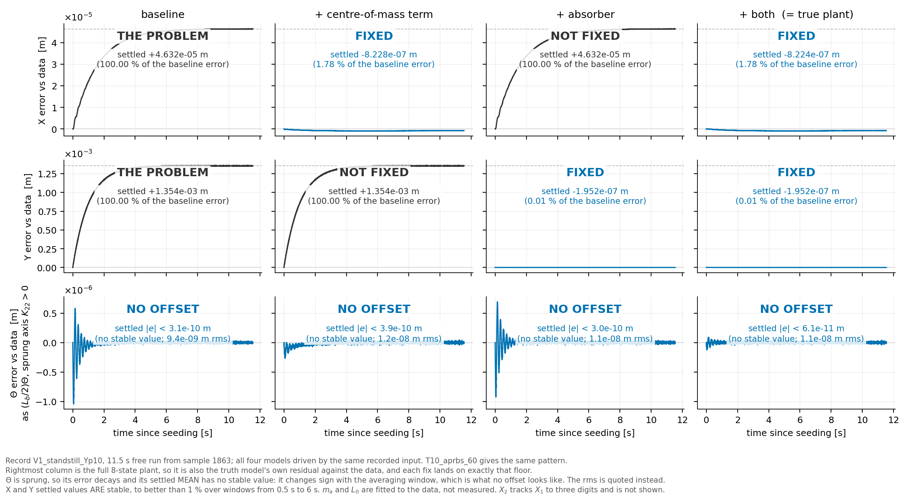

Slide 18
Centre of mass mismatch between baseline and system. Adjusting this for the baseline fixes the offset in X, but not for Y

Slide 20
Adding the absorber to the baseline fixes the Y offset but not the X offset

Slide 21
Adding both gives us back the system with MSD → no offset
Since baseline model = system

Slide 22
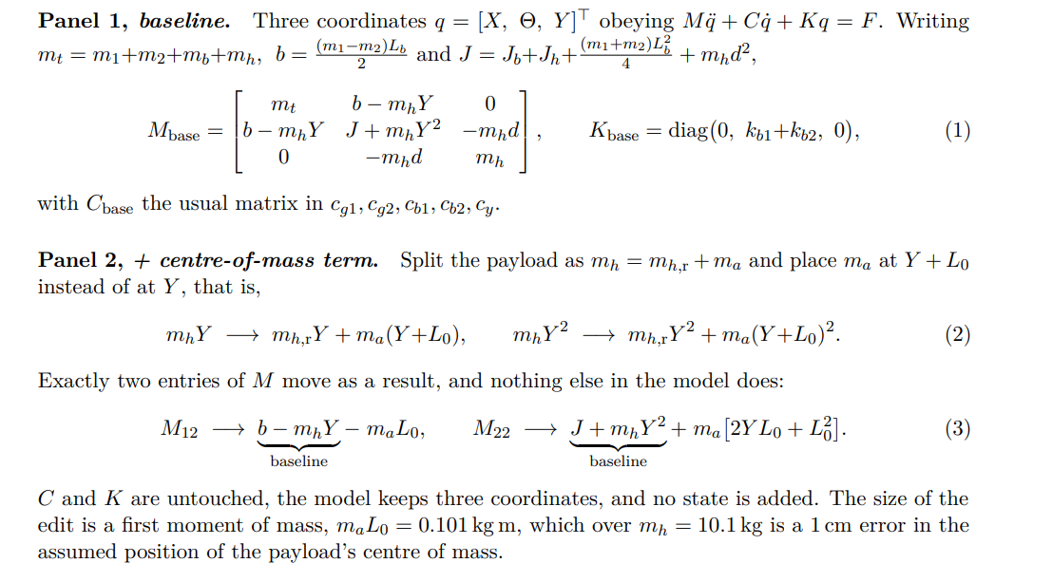
Centre of mass mismatch
Notes:
X and Y have no springs.
Nothing pulls those stages back to a set position, so any error the model makes just stays there. Theta does have springs, so whatever happens to it, it comes back. That is K11 = K33 = 0 and K22 > 0.
Centre of mass, panel 2, fixes X
The baseline assumes the payload's mass sits in slightly the wrong place, off by about 1 cm. Whenever the bridge twists, mass in the wrong place produces the wrong sideways force. A wrong force on a free axis leaves the stage in the wrong place, and it stays there.
Absorber, panel 3, fixes Y
In the real machine a small part of the payload sits on a spring and can move by itself. When we start the replay it is already moving. The baseline has no such part, so it cannot know that. In reality that moving mass pushes the Y stage as it settles down. The baseline never receives that push, so Y ends up in the wrong place, and stays there.

Slide 23
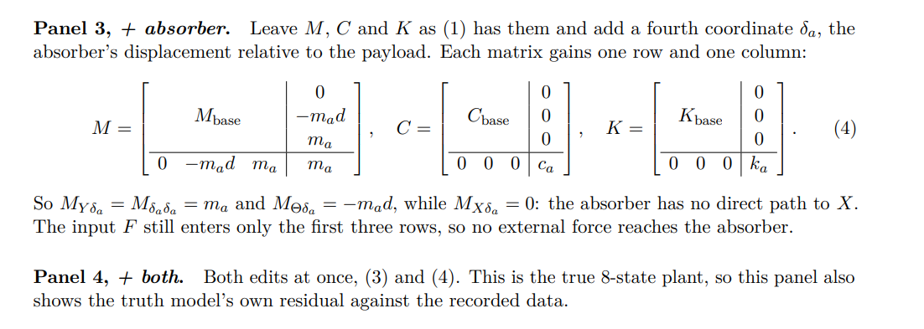
Notes:
X and Y have no springs.
Nothing pulls those stages back to a set position, so any error the model makes just stays there. Theta does have springs, so whatever happens to it, it comes back. That is K11 = K33 = 0 and K22 > 0.
Centre of mass, panel 2, fixes X
The baseline assumes the payload's mass sits in slightly the wrong place, off by about 1 cm. Whenever the bridge twists, mass in the wrong place produces the wrong sideways force. A wrong force on a free axis leaves the stage in the wrong place, and it stays there.
Absorber, panel 3, fixes Y
In the real machine a small part of the payload sits on a spring and can move by itself. When we start the replay it is already moving. The baseline has no such part, so it cannot know that. In reality that moving mass pushes the Y stage as it settles down. The baseline never receives that push, so Y ends up in the wrong place, and stays there.

Slide 24
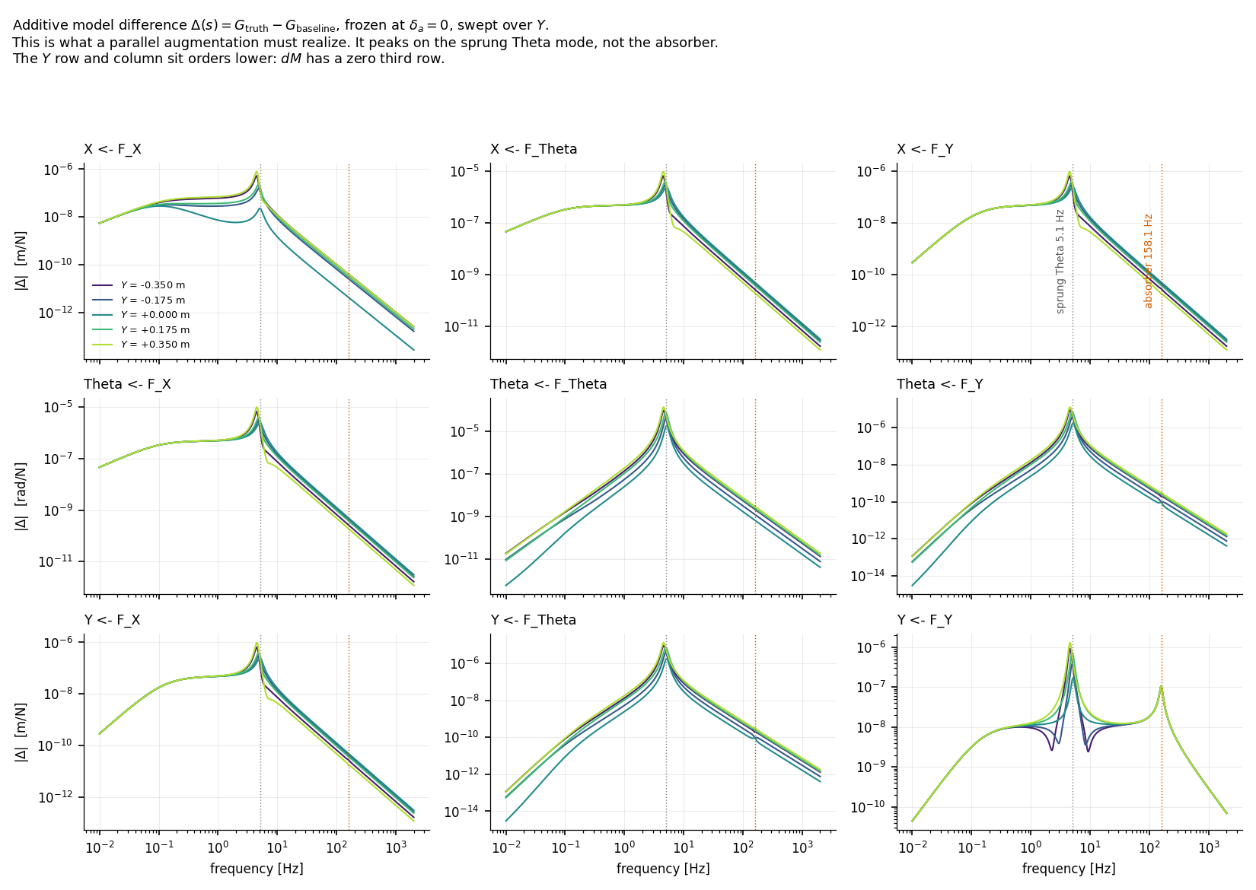
Difference between Gtruth-Gbaseline
Added absorber resonance peak in Y
Highest mismatch in Theta
Notes:
dM =
[ 0 -ma*L0 0 ]
[ -ma*L0 ma*(2*Y*L0 + L0^2) 0 ]
[ 0 0 0 ]

Slide 25
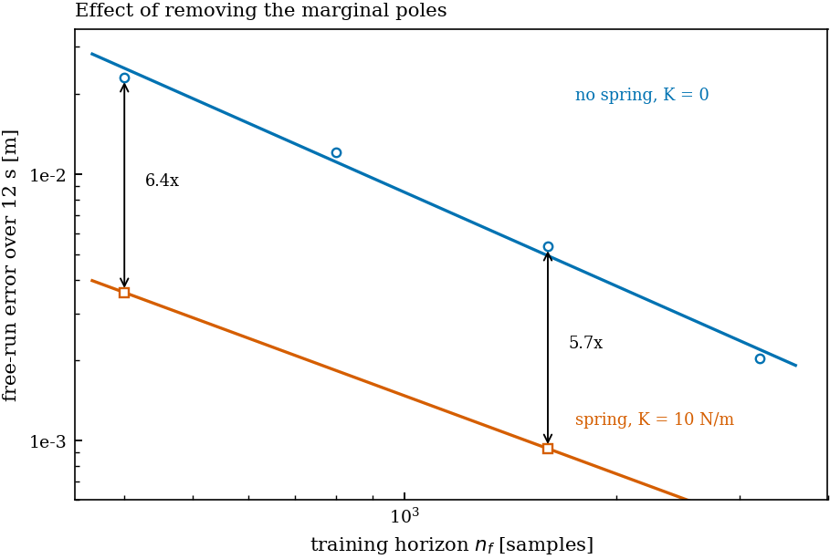
Adding stiffness did not fix the offset issue
Adding stiffnes to X and Y to both the model AND system
→ Does not remove the offset

Slide 26
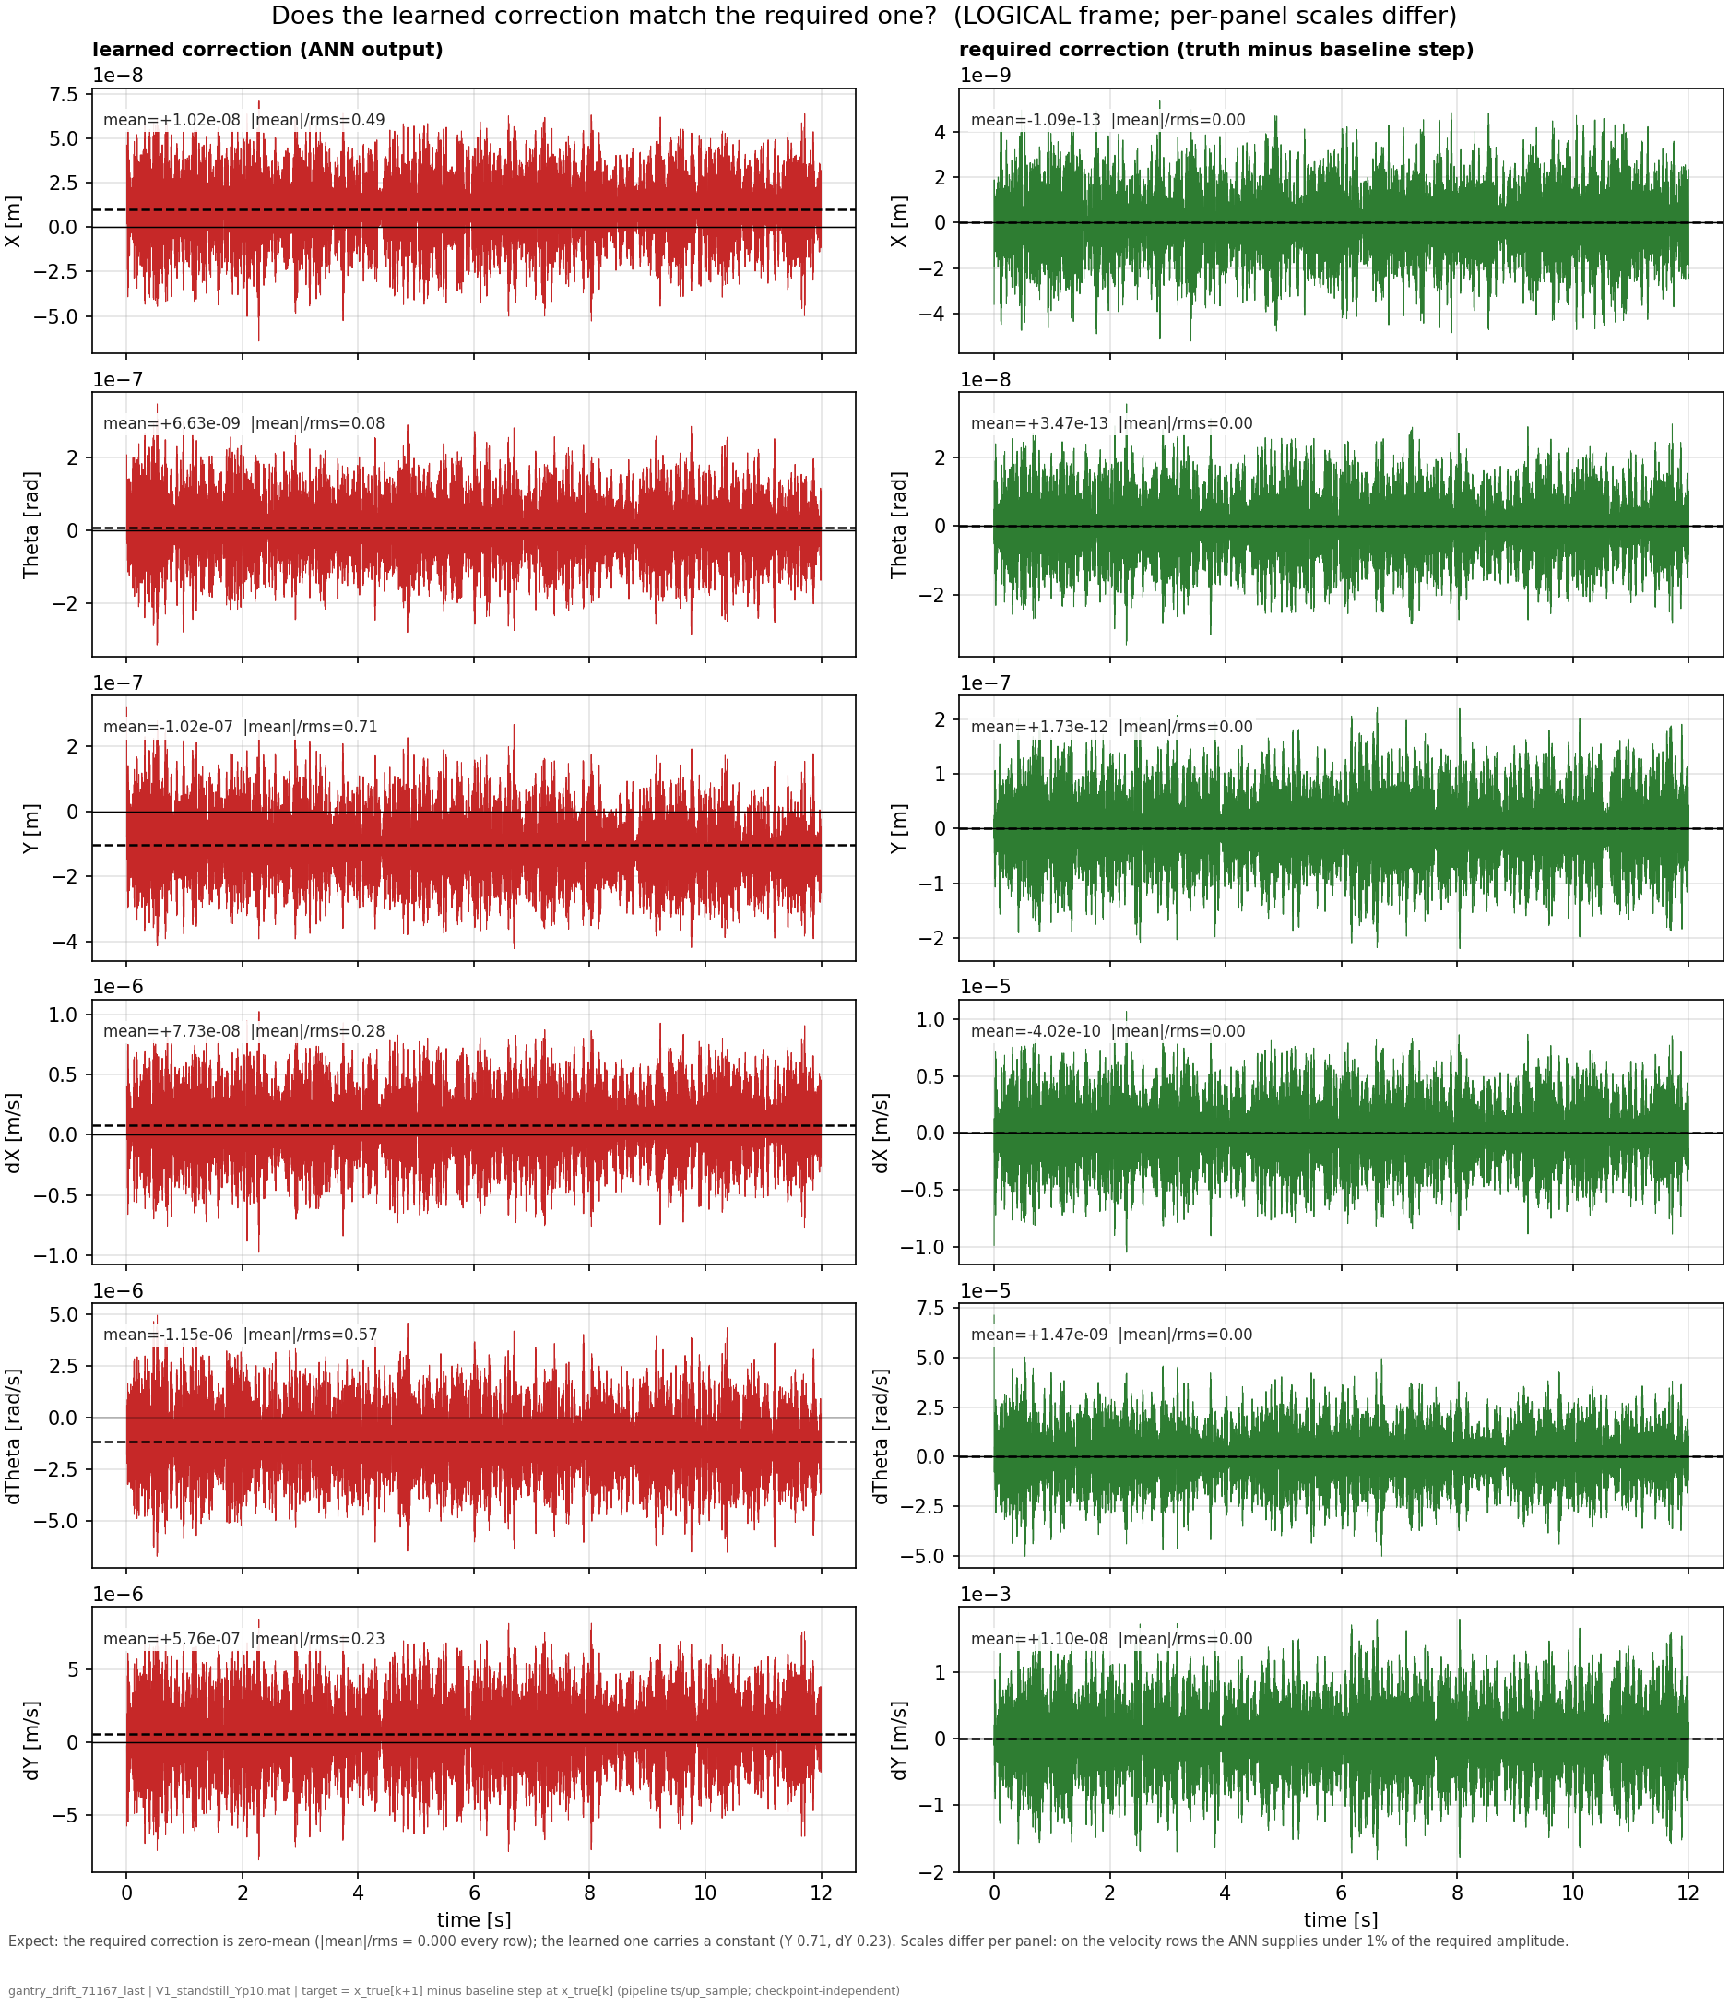
Compare ANN output against perfect correction
For reference:
  The correct correction for the ANN is zero-mean
Truth - baseline = zero-mean
Notes:
Currently not showing augmented states
Negation?

Slide 27
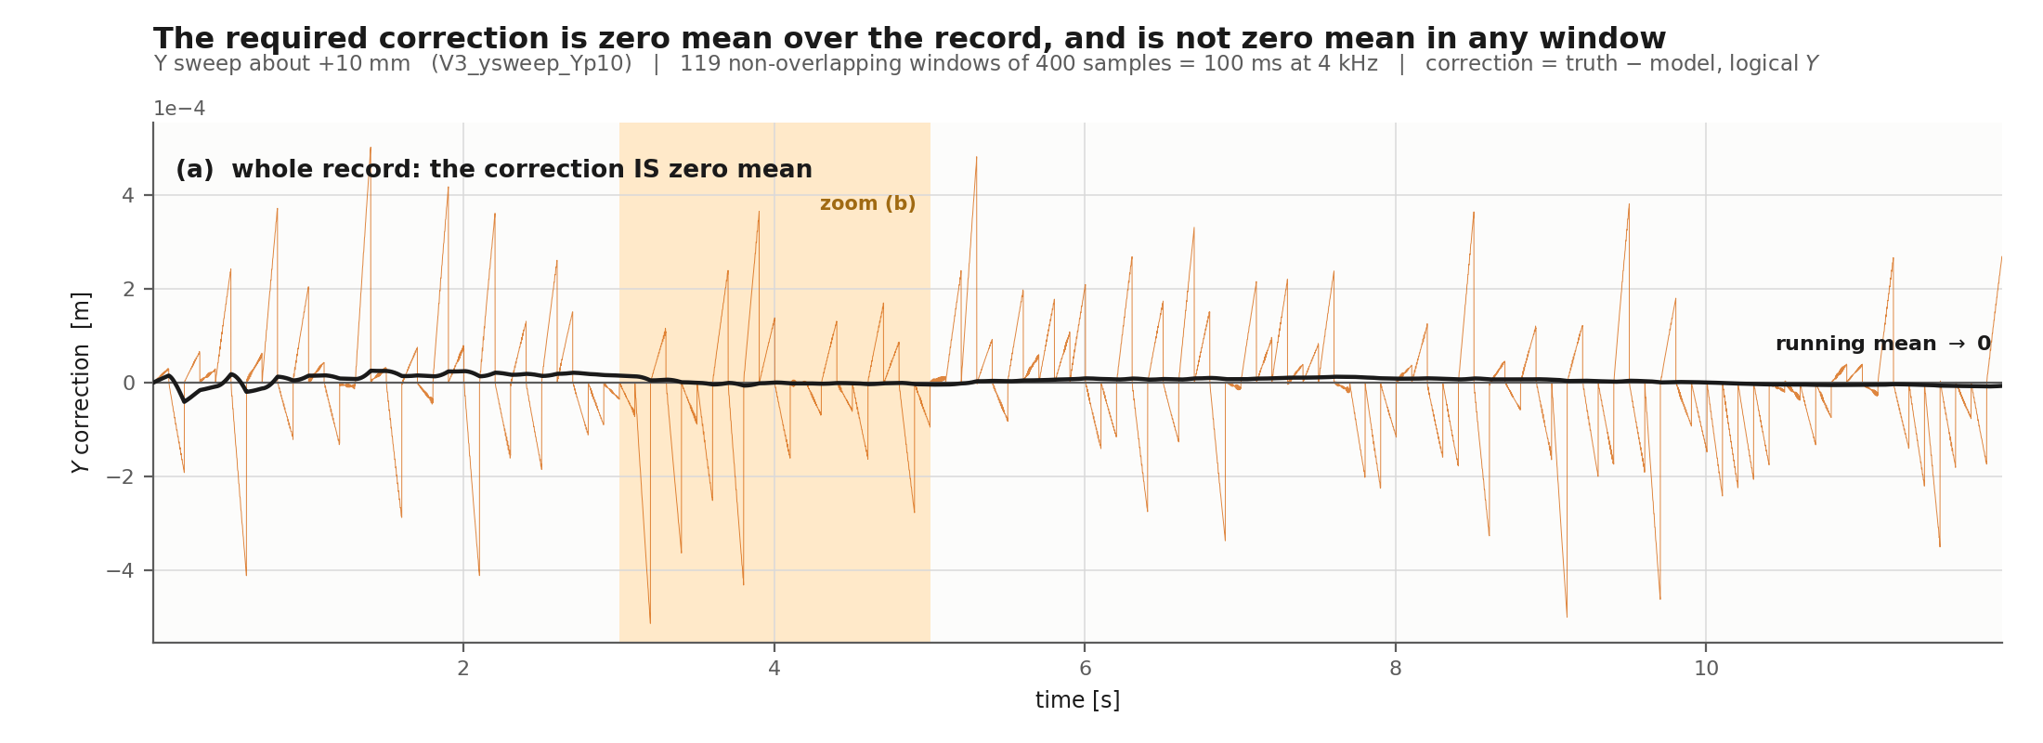
Notes:
The per-window training target is not the augmentation error. It is dominated by an unmodelled initial condition, and because Y has no restoring force that IC error integrates over the window instead of decaying.

Slide 28
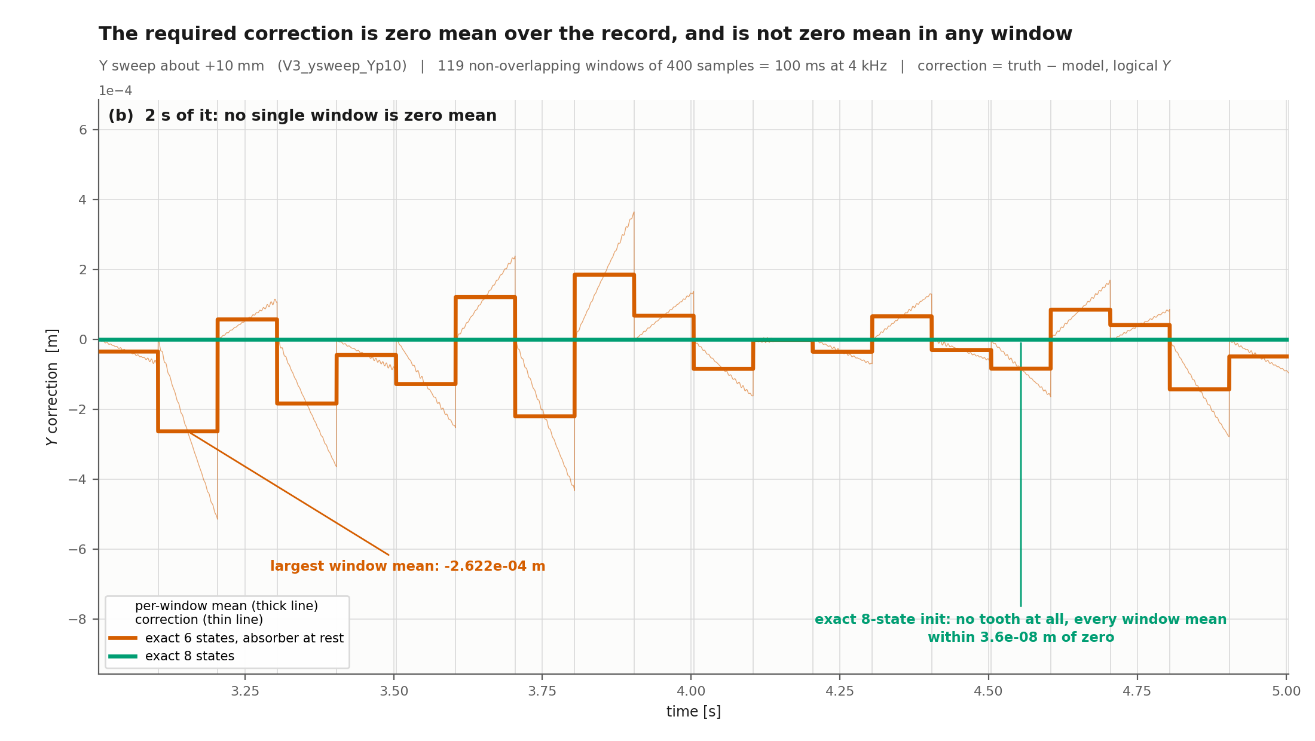
Notes:
At the window start the six physical states are set exactly to the truth, so the error is exactly zero. But the truth's absorber is mid-oscillation carrying momentum vdelta_a(s), and the model has nowhere to put it, so the model's payload starts with a velocity deficit of (m_a/m_h)*vdelta_a(s).
Y has no restoring force (K = 0 on that axis). A velocity deficit on a free axis does not decay, it integrates. So:
velocity error ≈ -(m_a/m_h) * vdelta_a(s) constant over the windowposition
error ≈ -(m_a/m_h) * vdelta_a(s) * t linear in elapsed time
That is the ramp. It runs for the 100 ms of the window and then the next window re-seeds and it snaps back to zero. Sharp edge = the reset, straight ramp = the integrating deficit.
The per-window training target is not the augmentation error. It is dominated by an unmodelled initial condition, and because Y has no restoring force that IC error integrates over the window instead of decaying.

Slide 29
The model cannot represent the absorber's momentum at the window start. That missing momentum appears as a velocity deficit on the payload, and because Y has no restoring force it integrates over the window rather than decaying, producing a per-window offset.
Notes:
At the window start the six physical states are set exactly to the truth, so the error is exactly zero. But the truth's absorber is mid-oscillation carrying momentum vdelta_a(s), and the model has nowhere to put it, so the model's payload starts with a velocity deficit of (m_a/m_h)*vdelta_a(s).
Y has no restoring force (K = 0 on that axis). A velocity deficit on a free axis does not decay, it integrates. So:
velocity error ≈ -(m_a/m_h) * vdelta_a(s) constant over the windowposition
error ≈ -(m_a/m_h) * vdelta_a(s) * t linear in elapsed time
That is the ramp. It runs for the 100 ms of the window and then the next window re-seeds and it snaps back to zero. Sharp edge = the reset, straight ramp = the integrating deficit.
The per-window training target is not the augmentation error. It is dominated by an unmodelled initial condition, and because Y has no restoring force that IC error integrates over the window instead of decaying.

Slide 30
The per-window training target is not the augmentation error. It is dominated by an unmodelled initial condition, and because Y has no restoring force that IC error integrates over the window instead of decaying.

Slide 31
On standstill trajectories
Only multisine excitation
1. On Y the offset is gone, for every arm. All trailing means are ~2e-09 m. So by the criterion as stated, Y is clean. But note this was already true of base3: a free replay from the rest IC has no absorber initial-condition deficit, so the Y error is oscillatory with near-zero mean. The stage-1 1.0278e-04 was a seeded per-window quantity, not this one.

Slide 32
What is causing this problem

Slide 33
Why is ANN only not training?

Slide 34
Coulomb friction worth discussing?

Slide 35
Look at other slides saved.

Slide 36
Velocity routing like Roland said…

Slide 37
That is, I think, the reconciliation with your supervisor. The offset is gone from the model: seeded exactly, the settled DC drops 1.9556e-03 → 1.1504e-09 m and becomes seed-time independent. But the encoder's x0 estimate is not exact, and an x0 error on a K = 0 axis integrates exactly the way the absorber momentum deficit used to

Slide 38
i.e. proportional to the mismatch in absorber velocity at that window's start, vdelta_a_true(s_i) - vdelta_a_model(s_i).

Slide 39
ANN only training
Random init: the network starts from random weights and has to discover the plant's dynamics by gradient descent.
BLA init: a linear model is first identified from the same input-output data by subspace identification, then written into the network, so training starts from the best linear description of the plant instead of from noise.
The difference: Gradient descent never finds the two poles at z = 1, stopping at |lambda| = 0.86 after 85,000 updates.
  The network keeps them during training
Notes:
Take u and y from the training record, normalised.
Run N4SID, a subspace identification method. This is linear algebra, an SVD and least squares. It is not iterative, has no learning rate and no local minima.
Out comes an 8-state linear system A, B, C, D. On our data its poles are [0.999982, 0.999981, 0.999212, 0.998775, 0.897112, 0.897112, 0.259645, 0.061158], so it finds the two integrators to within 1.755e-05 of z = 1.
Write those matrices into the neural network so that at step zero the network computes exactly x⁺ = Ax + Bu and y = Cx + Du. Training continues from there, with the nonlinear parts starting at zero and learning the residual.

Slide 40
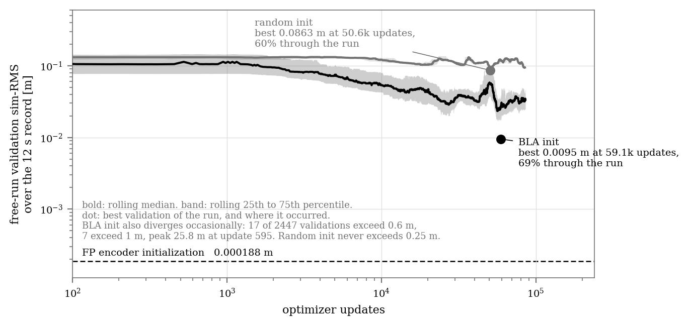

Slide 41
Our learned model is x⁺ = f(x, u) where f is a neural network. There is no A.
  How to get the poles, linearize: take the Jacobian J = df/dx at some specific state and input, which gives an 8x8 matrix describing how a small perturbation around that point grows or decays.
Evaluated at five places spread along the validation record, giving 5 x 8 = 40 eigenvalues per model
Notes:
The learned models are nonlinear, so their local poles depend on where along the validation record you linearise. I sampled five points to show that the result is not an artefact of one lucky spot. The spread you see within each learned set is operating-point variation, and it is small: the random arm ranges 0.8556 to 0.8676 on its largest mode, the BLA arm 1.0000 to 1.0186.

Slide 42
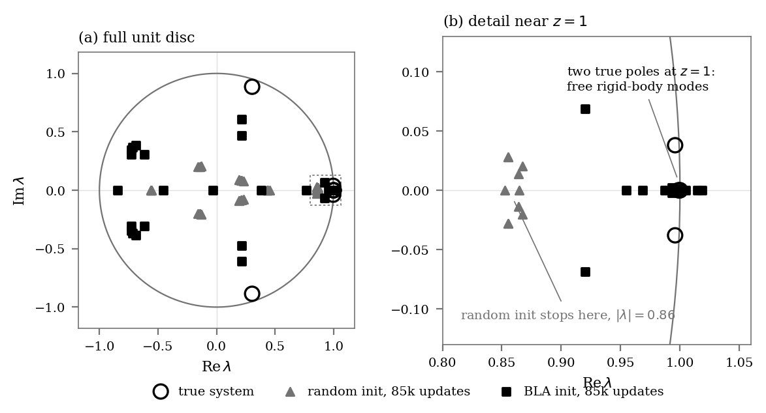

Slide 43
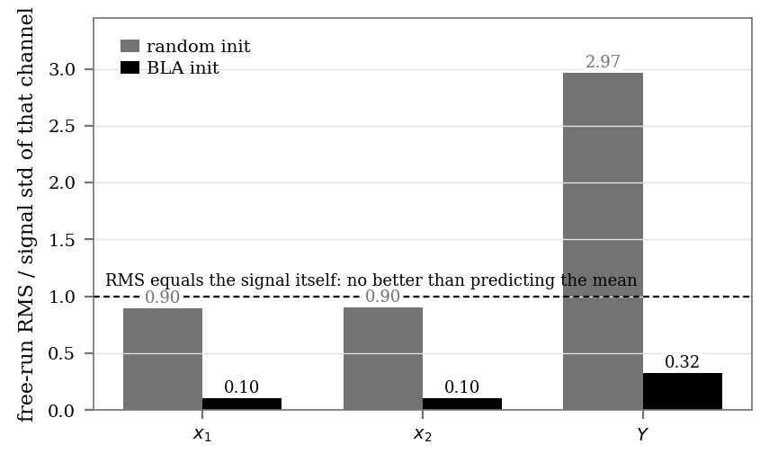

Slide 44
To do
Possible to ask for extension?
  Else implementing on real data does not seem realistic to me
Still need to fix training issue before I can proceed
  Window mismatch
  Offset

Slide 46
Show zero mean correction for complete trajectory
But once we split it up in windows without correct initialization, its not

Slide 47
ANN only not learning
Any explanation for that
It does learn for Jan’s ecc
It is learning, but really slow?
BLA init…?

Slide 48
The one-sentence answer. The gantry has two free rigid-body modes, because _K4 has zeros on X and Y, so its position states have infinite memory. Jan's MSD is bolted to ground and every mode decays within a few seconds. A model that forgets is the correct answer for Jan's system and a fatally wrong one for the gantry, and the training objective cannot tell the difference.Why the objective cannot tell. SUBNET re-initialises the state from the encoder at the start of every training window. The window is nf = 400, half a second. Within half a second the model never has to hold anything: the output is reproducible from the input plus a short-memory state. So no gradient ever rewards long memory. Validation, by contrast, is a 12 second free run, 9600 steps with no measurements, where position error accumulates forever if the integrators are missing. The objective is blind to precisely the property the metric punishes.The evidence for that is on the gantry itself, and it is interventional. This is the part to show your supervisor, because it needs no MSD experiment: learned max|lambda| modes>0.999 score vs constant predictorrandom init 0.65 - 0.82 0 0.1289 0.90xBLA init (N4SID) 1.0018 2 0.0335 0.228xtrue system 1.0000 2Same data, same architecture, same objective, same seed. Only the initialisation differs. Random initialisation produces a model whose slowest mode decays in 4 ms and which barely beats a constant. A linear subspace identification finds the integrators to within 1.755e-05 of z = 1, and when the network is started there it keeps them through 5215 updates and gets 4x better. Gradient descent cannot find them; it can hold them.Why gradient descent will not find them. |lambda| = 1 is a boundary. Below it the model decays and is safe. Above it, error over a 9600-step free run amplifies as lambda^9600, so 1.001 becomes a factor of 15,000. There is no gradient signal within a 400-step window that rewards sitting exactly on that boundary, and considerable risk in approaching it. The optimiser retreats to safety, which is exactly what 0.65 to 0.82 looks like.Two other differences that plausibly compound it, both measured, neither yet tested causally: on T10, 92.5% of the input power is below 20 Hz and the identification-relevant residual is 0.02% of the Y output, so the MSE is dominated by gross motion rather than dynamics, whereas Jan's output is his excitation response. And the gantry is 3-in/3-out with Y-dependent inertia against his SISO system, while both use the same 2x8 and 2x16 networks, so his encoder sees 26 inputs and ours sees 102 at identical width.Status of the MSD experiment, stated plainly. It was meant to be the clean single-variable confirmation. As run it is invalid because of my noise-scaling error, and I would not show arms B and C in their current form. The corrected verst an hour. If they reproduce the collapse at Jan's absolute noise, youhave the controlled demonstration on a known-good benchmark. If they do not, then the gantry evidence above still stands on its own and the story becomes narrower but is not overturned.
The one-sentence answer. The gantry has two free rigid-body modes, because _K4 has zeros on X and Y, so its position states have infinite memory. Jan's MSD is bolted to ground and every mode decays within a few seconds. A model that forgets is the correct answer for Jan's system and a fatally wrong one for the gantry, and the training objective cannot tell the difference.

